Slide 1
Design of Engineering Experiments
Part 5 – The 2^{k} Factorial Design
Text reference, Chapter 6
Special case of the general factorial design; k factors, all at two levels
The two levels are usually called low and high (they could be either quantitative or qualitative)
Very widely used in industrial experimentation
Form a basic “building block” for other very useful experimental designs (DNA)
Special (short-cut) methods for analysis
We will make use of Design-Expert

Slide 3
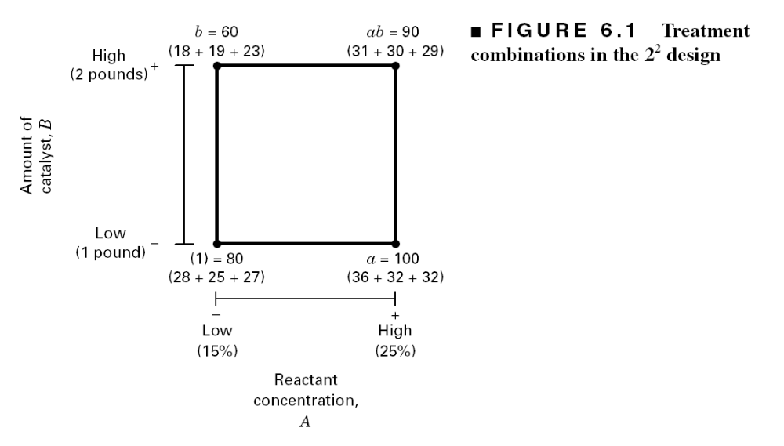
The Simplest Case: The 2²
“-” and “+” denote the low and high levels of a factor, respectively
Low and high are arbitrary terms
Geometrically, the four runs form the corners of a square
Factors can be quantitative or qualitative, although their treatment in the final model will be different

Slide 4
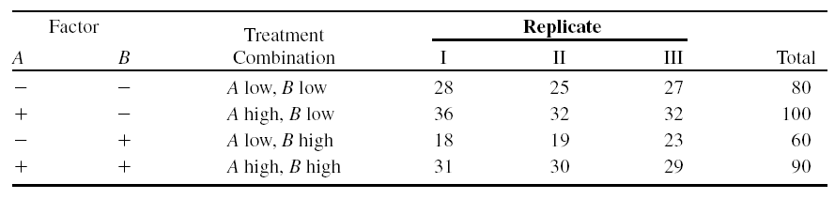
Chemical Process Example
A = reactant concentration, B = catalyst amount, y = recovery

Slide 5
Analysis Procedure for a
Factorial Design
Estimate factor effects
Formulate model
  With replication, use full model
  With an unreplicated design, use normal probability plots
Statistical testing (ANOVA)
Refine the model
Analyze residuals (graphical)
Interpret results

Slide 6
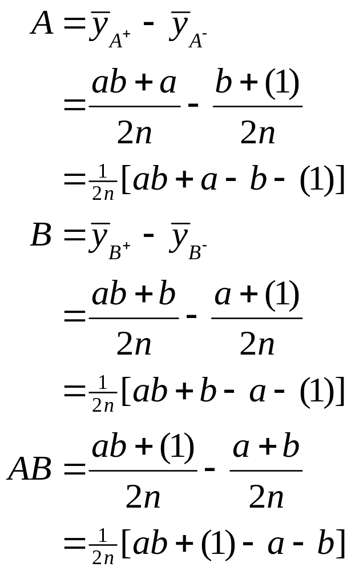
Estimation of Factor Effects
See textbook, pg. 209-210 For manual calculations
The effect estimates are: A = 8.33, B = -5.00, AB = 1.67
Practical interpretation?
Design-Expert analysis

Slide 7
Estimation of Factor Effects
Form Tentative Model
Term Effect SumSqr % Contribution
Model Intercept
Model A 8.33333 208.333 64.4995
Model B -5 75 23.2198
Model AB 1.66667 8.33333 2.57998
Error Lack Of Fit 0 0
Error P Error 31.3333 9.70072
Lenth's ME 6.15809
Lenth's SME 7.95671

Slide 8
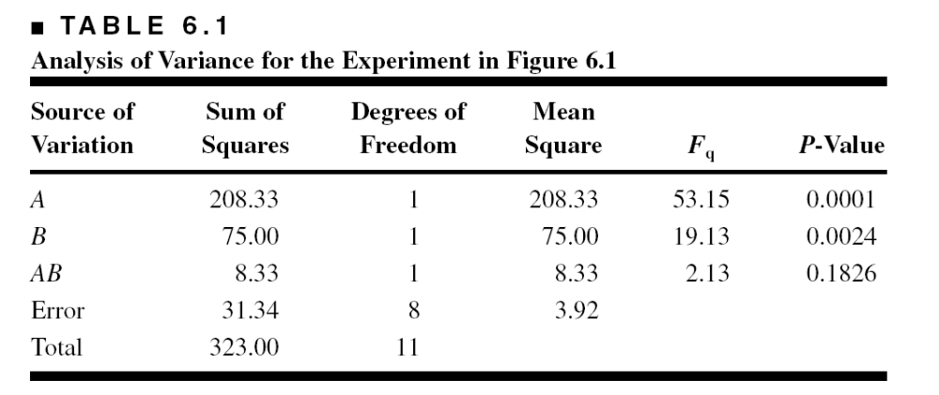
Statistical Testing - ANOVA
The F-test for the “model” source is testing the significance of the overall model; that is, is either A, B, or AB or some combination of these effects important?

Slide 9
Residuals and Diagnostic Checking

Slide 10
The Response Surface

Slide 11
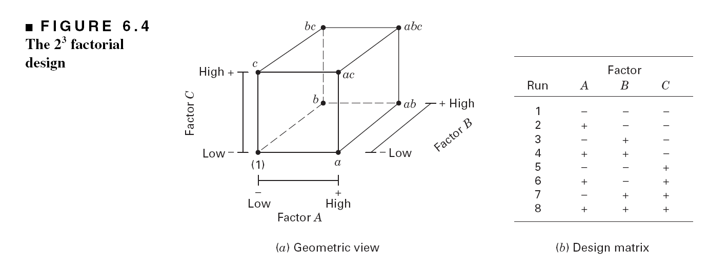
The 2³ Factorial Design

Slide 12
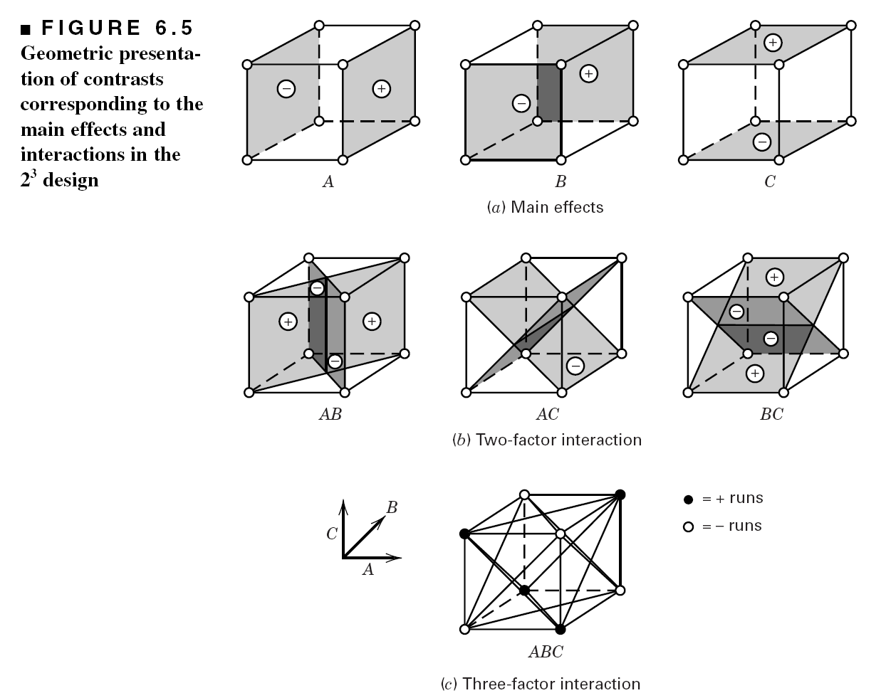
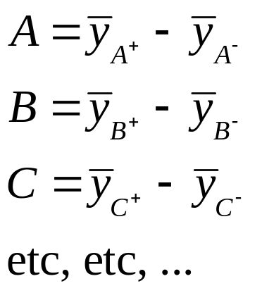
Effects in The 2³ Factorial Design
Analysis done via computer

Slide 13
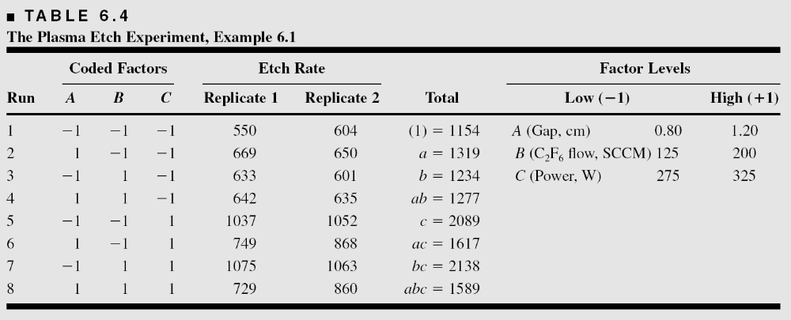
An Example of a 2³ Factorial Design
A = gap, B = Flow, C = Power, y = Etch Rate

Slide 14
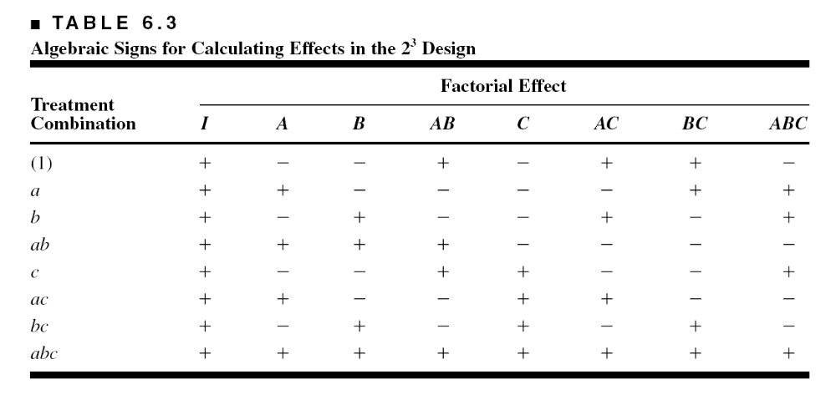
Table of – and + Signs for the 2³ Factorial Design (pg. 218)

Slide 15
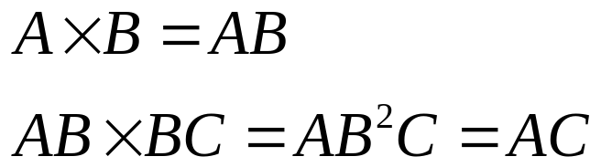
Properties of the Table
Except for column I, every column has an equal number of + and – signs
The sum of the product of signs in any two columns is zero
Multiplying any column by I leaves that column unchanged (identity element)
The product of any two columns yields a column in the table:
Orthogonal design
Orthogonality is an important property shared by all factorial designs

Slide 16
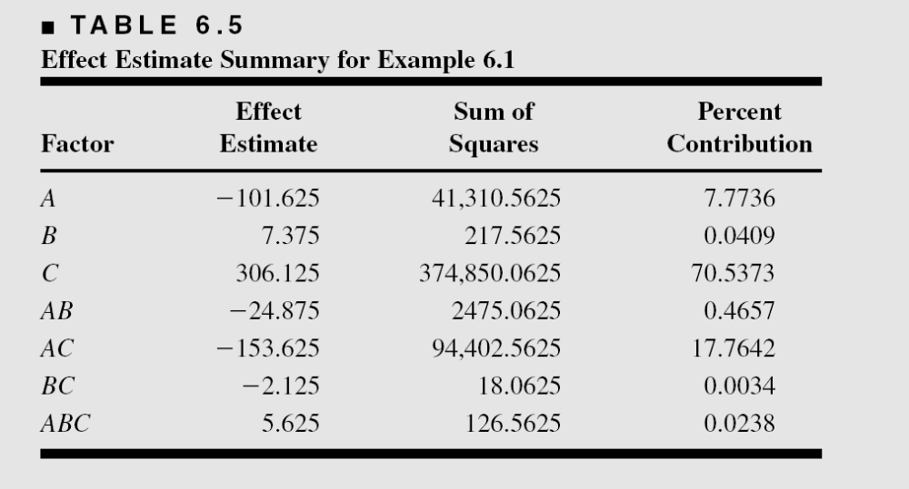
Estimation of Factor Effects

Slide 17
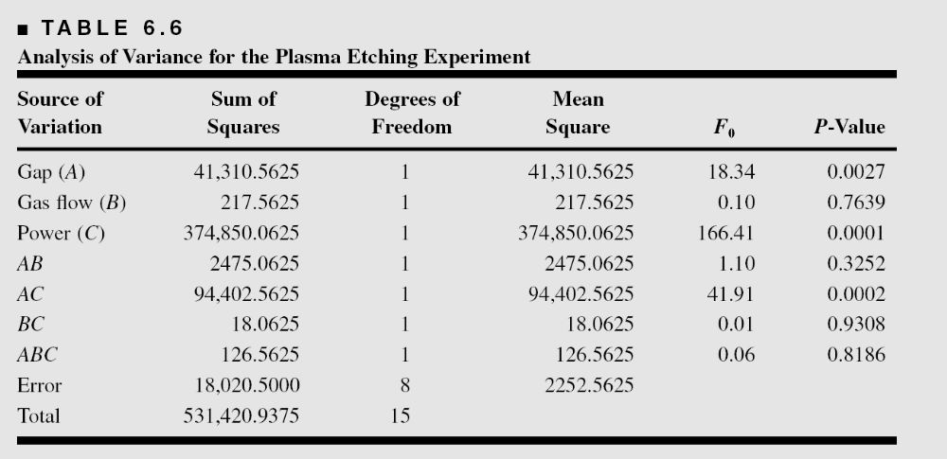
ANOVA Summary – Full Model

Slide 18
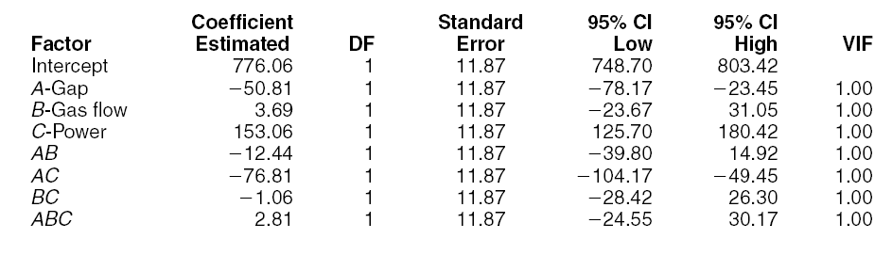
Model Coefficients – Full Model

Slide 19
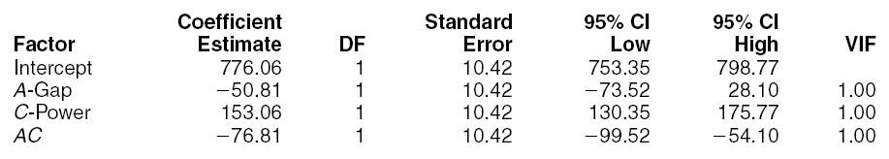
Model Coefficients – Reduced Model

Slide 20
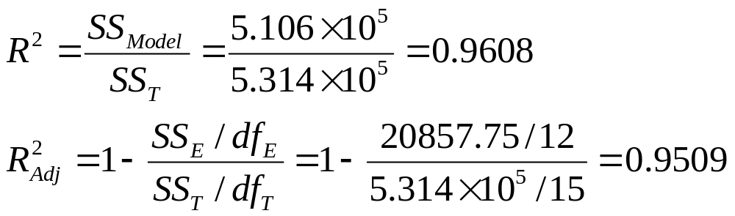
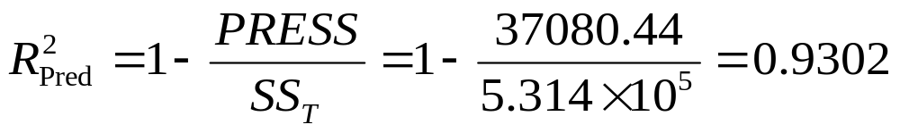
Model Summary Statistics for Reduced Model
R² and adjusted R²
R² for prediction (based on PRESS)

Slide 21
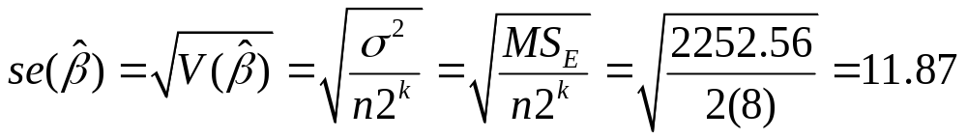
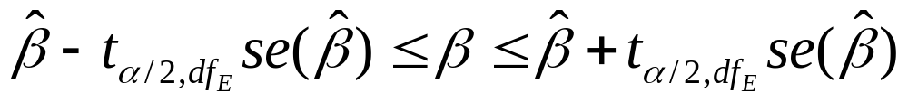
Model Summary Statistics
Standard error of model coefficients (full model)
Confidence interval on model coefficients

Slide 22
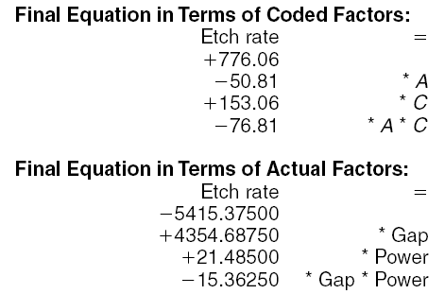
The Regression Model

Slide 23
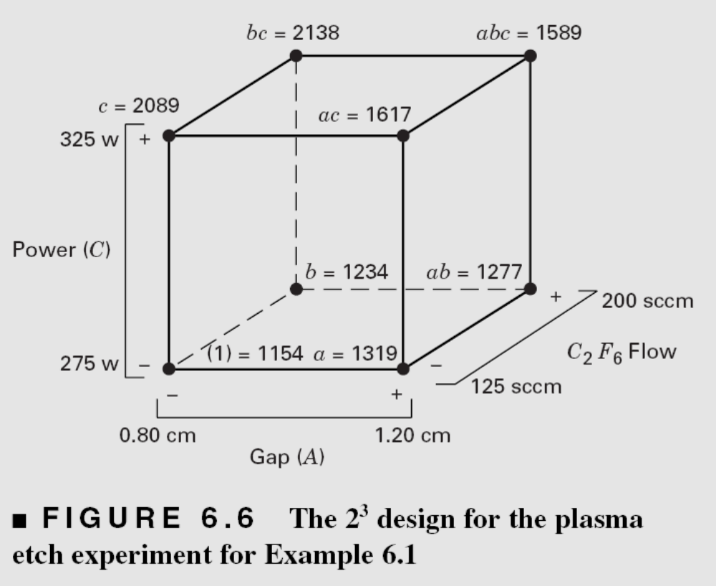
Model Interpretation
Cube plots are often useful visual displays of experimental results

Slide 24
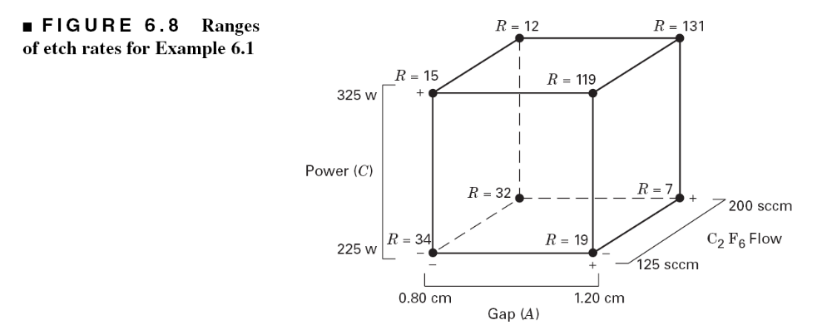
Cube Plot of Ranges
What do the large ranges when gap and power are at the high level tell you?

Slide 25
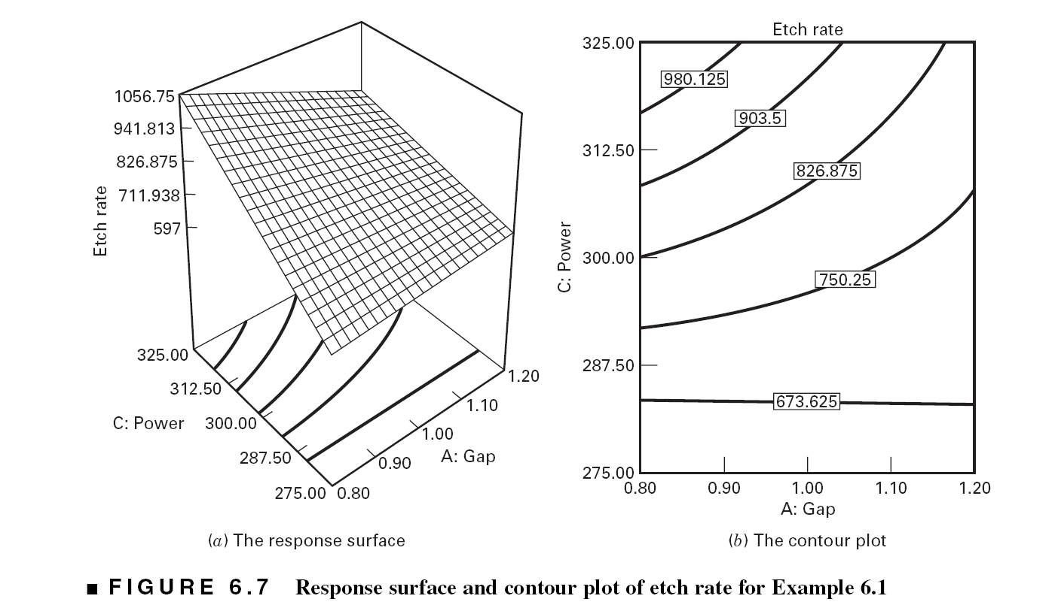

Slide 26
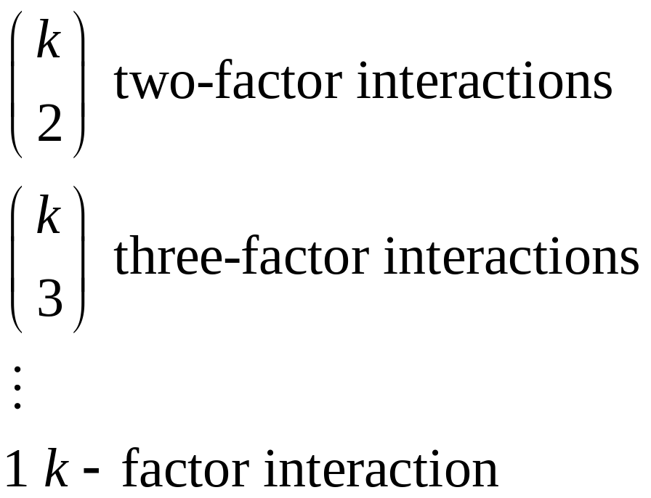
The General 2^{k} Factorial Design
Section 6-4, pg. 227, Table 6-9, pg. 228
There will be k main effects, and

Slide 27
6.5 Unreplicated 2^{k} Factorial Designs
These are 2^{k} factorial designs with one observation at each corner of the “cube”
An unreplicated 2^{k} factorial design is also sometimes called a “single replicate” of the 2^{k}
These designs are very widely used
Risks…if there is only one observation at each corner, is there a chance of unusual response observations spoiling the results?
Modeling “noise”?

Slide 28
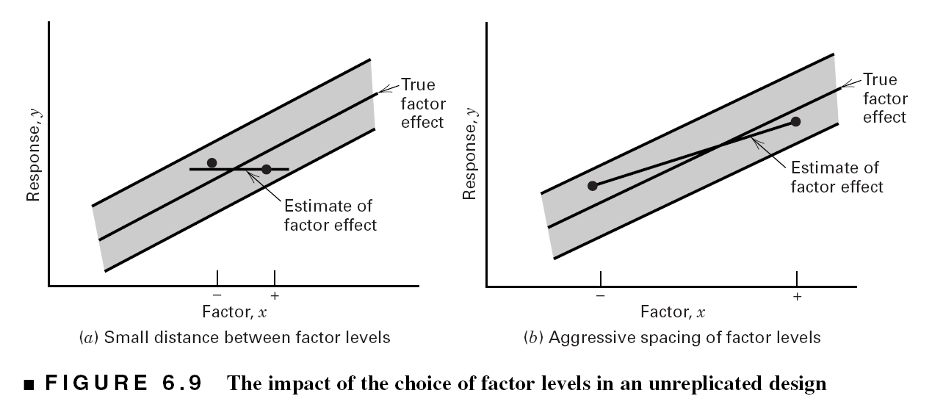
Spacing of Factor Levels in the Unreplicated 2^{k} Factorial Designs
If the factors are spaced too closely, it increases the chances that the noise will overwhelm the signal in the data
More aggressive spacing is usually best

Slide 29
Unreplicated 2^{k} Factorial Designs
Lack of replication causes potential problems in statistical testing
  Replication admits an estimate of “pure error” (a better phrase is an internal estimate of error)
  With no replication, fitting the full model results in zero degrees of freedom for error
Potential solutions to this problem
  Pooling high-order interactions to estimate error
  Normal probability plotting of effects (Daniels, 1959)
  Other methods…see text

Slide 30
Example of an Unreplicated 2^{k} Design
A 2⁴ factorial was used to investigate the effects of four factors on the filtration rate of a resin
The factors are A = temperature, B = pressure, C = mole ratio, D= stirring rate
Experiment was performed in a pilot plant

Slide 31
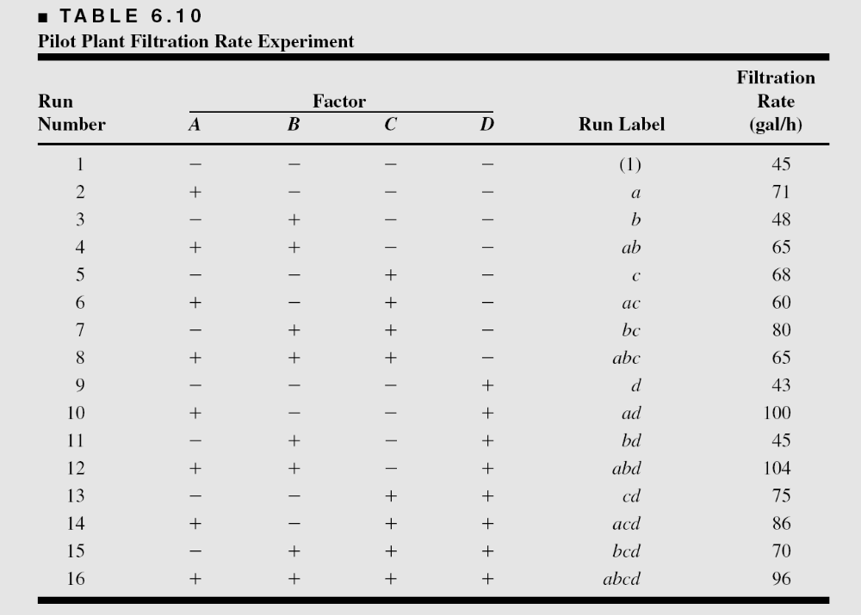
The Resin Plant Experiment

Slide 32
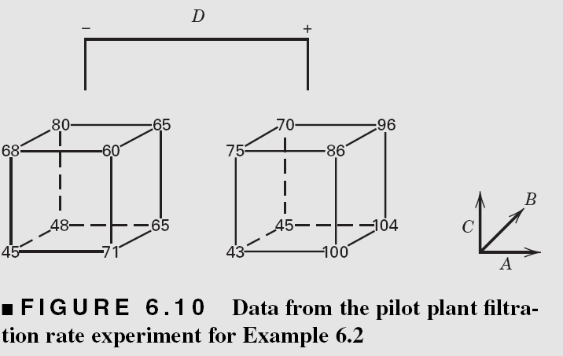
The Resin Plant Experiment

Slide 33
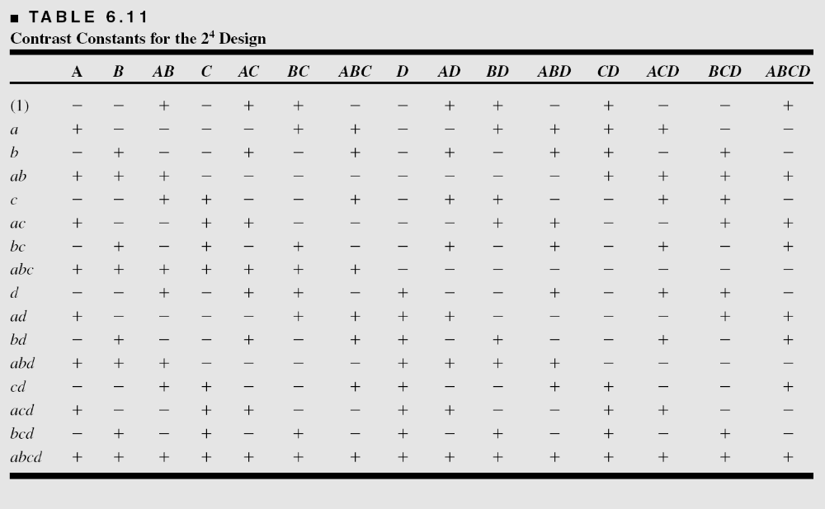

Slide 34
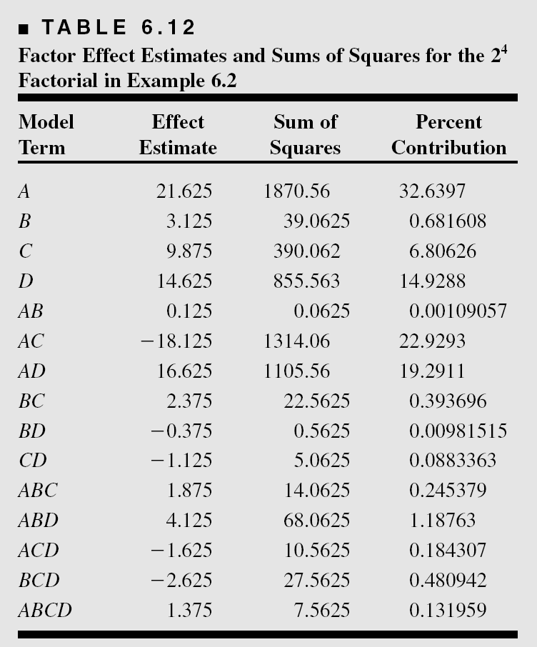
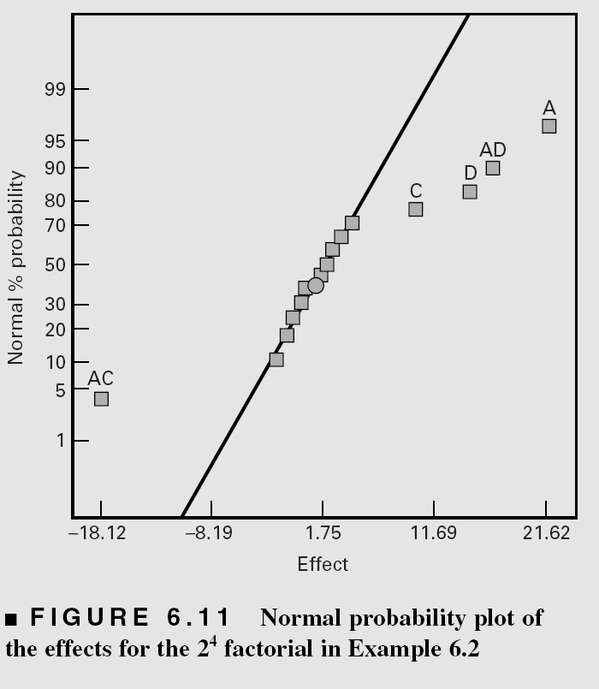
Estimates of the Effects

Slide 35
The Half-Normal Probability Plot of Effects

Slide 36
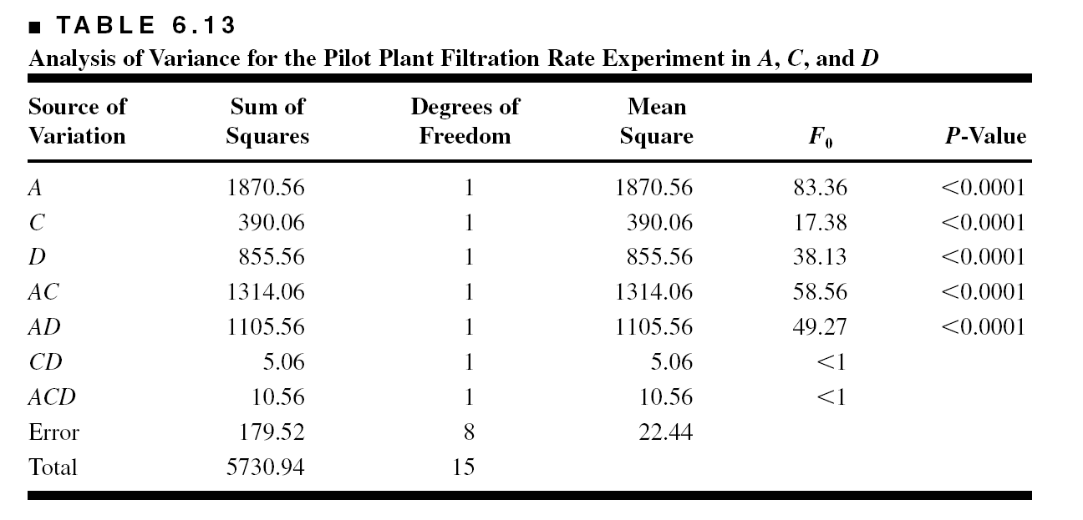
Design Projection: ANOVA Summary for the Model as a 2³ in Factors A, C, and D

Slide 37
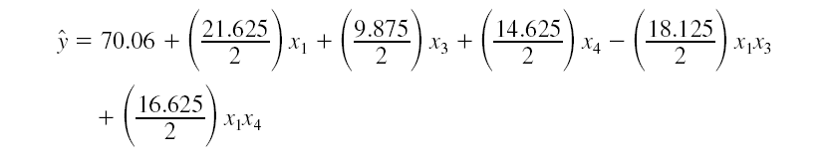
The Regression Model

Slide 38
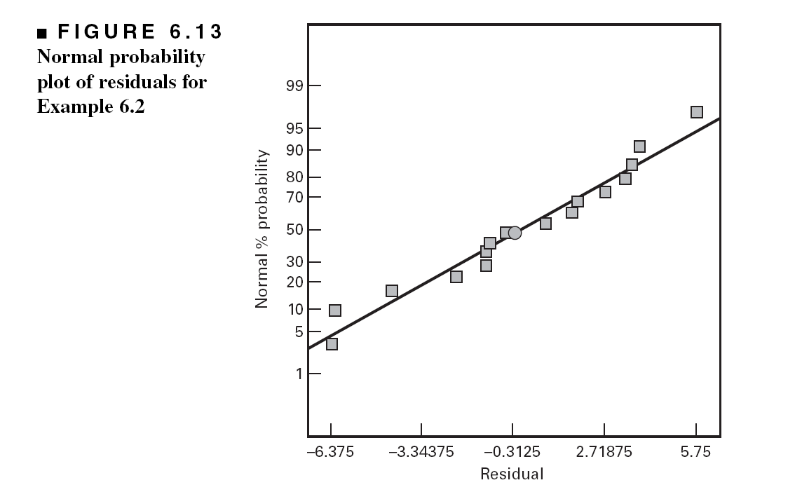
Model Residuals are Satisfactory

Slide 39
Model Interpretation – Main Effects and Interactions

Slide 40
Model Interpretation – Response Surface Plots
With concentration at either the low or high level, high temperature and high stirring rate results in high filtration rates

Slide 41
Outliers: suppose that cd = 375 (instead of 75)

Slide 42
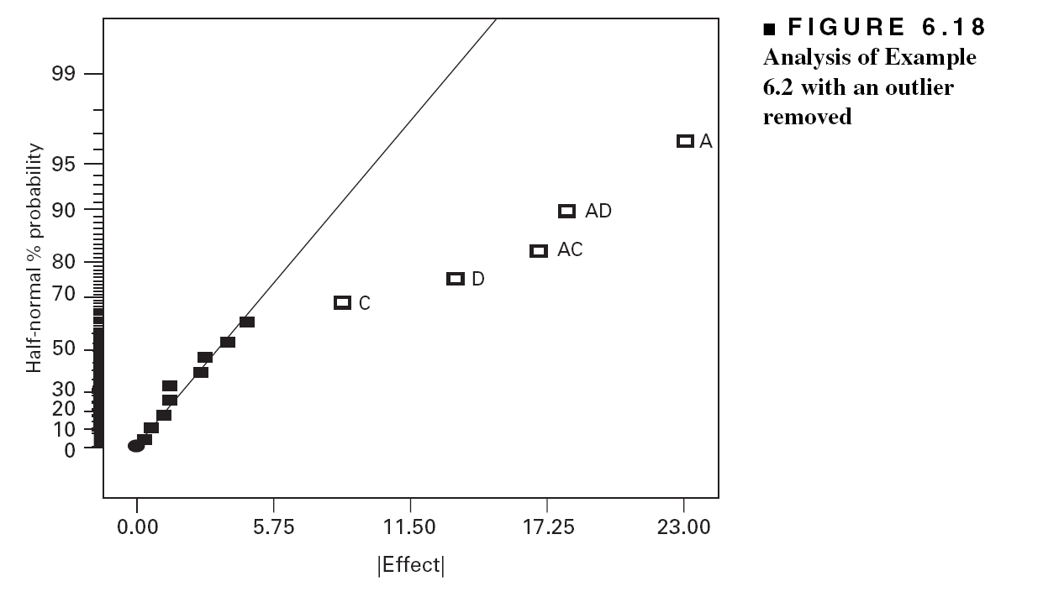

Slide 43
The Drilling Experiment
Example 6.3
A = drill load, B = flow, C = speed, D = type of mud, y = advance rate of the drill

Slide 44
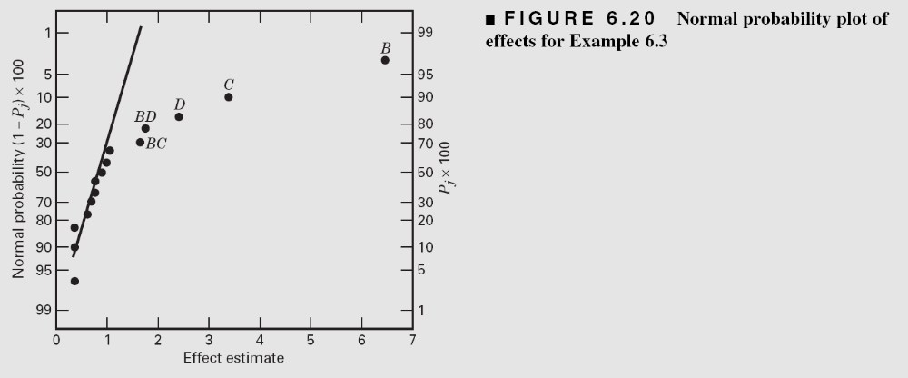
Normal Probability Plot of Effects –
The Drilling Experiment

Slide 45
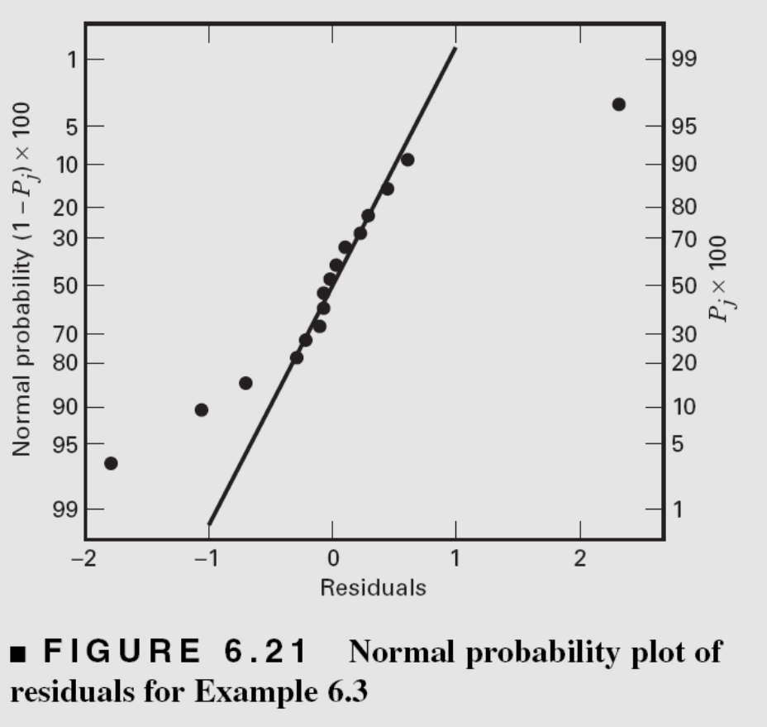
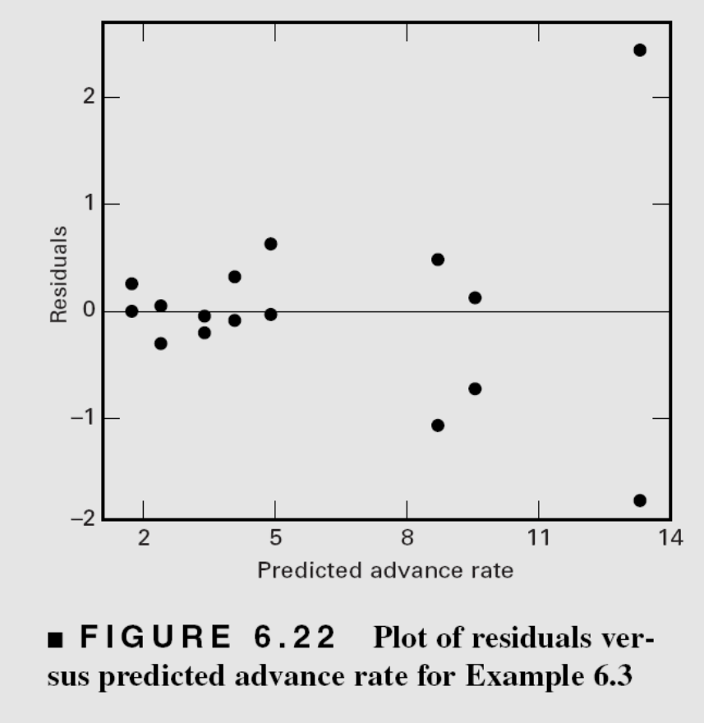
Residual Plots

Slide 46
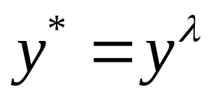
Residual Plots
The residual plots indicate that there are problems with the equality of variance assumption
The usual approach to this problem is to employ a transformation on the response
Power family transformations are widely used
Transformations are typically performed to
  Stabilize variance
  Induce at least approximate normality
  Simplify the model

Slide 47
Selecting a Transformation
Empirical selection of lambda
Prior (theoretical) knowledge or experience can often suggest the form of a transformation
Analytical selection of lambda…the Box-Cox (1964) method (simultaneously estimates the model parameters and the transformation parameter lambda)
Box-Cox method implemented in Design-Expert

Slide 48
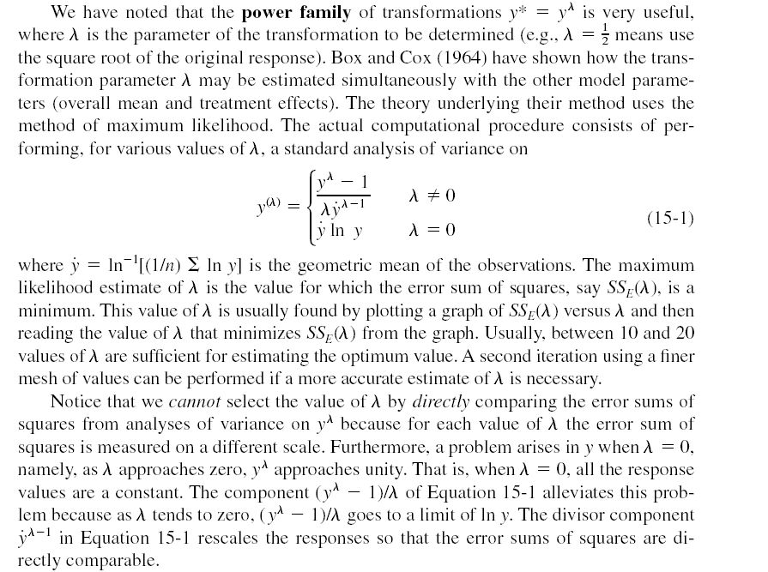
(15.1)

Slide 49
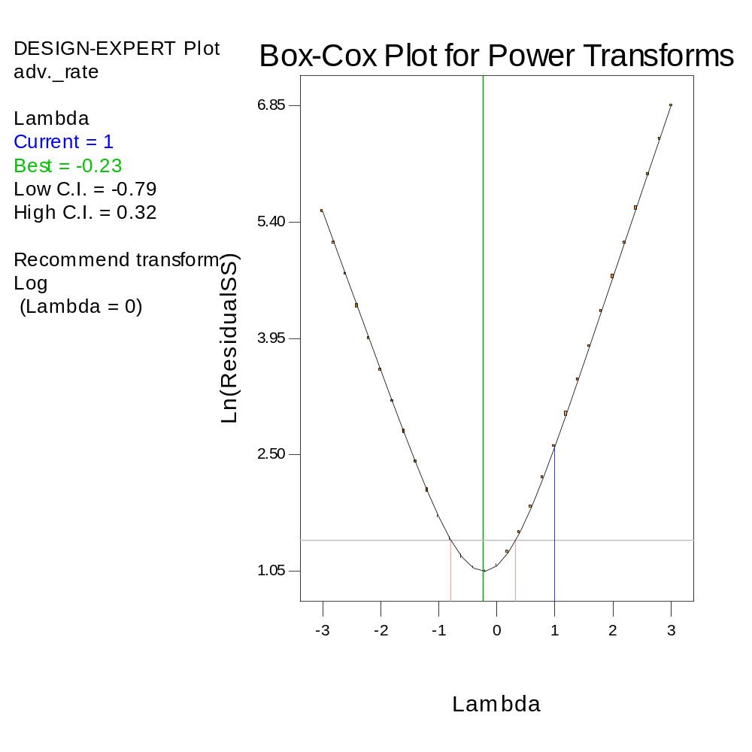
The Box-Cox Method
A log transformation is recommended
The procedure provides a confidence interval on the transformation parameter lambda
If unity is included in the confidence interval, no transformation would be needed

Slide 50
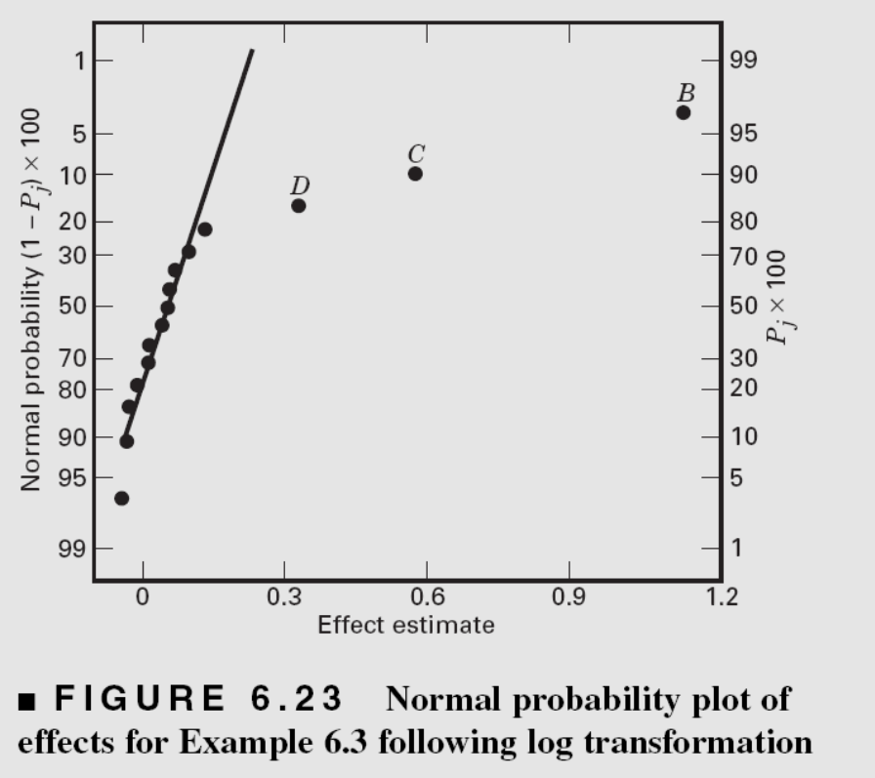
Effect Estimates Following the
Log Transformation
Three main effects are large
No indication of large interaction effects
What happened to the interactions?

Slide 51
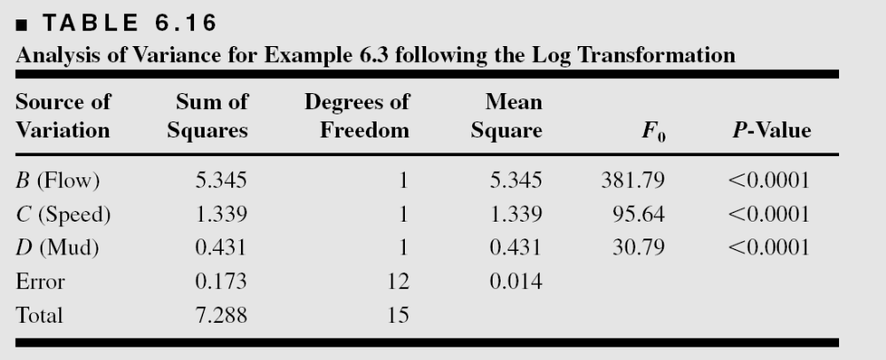
ANOVA Following the Log Transformation

Slide 52
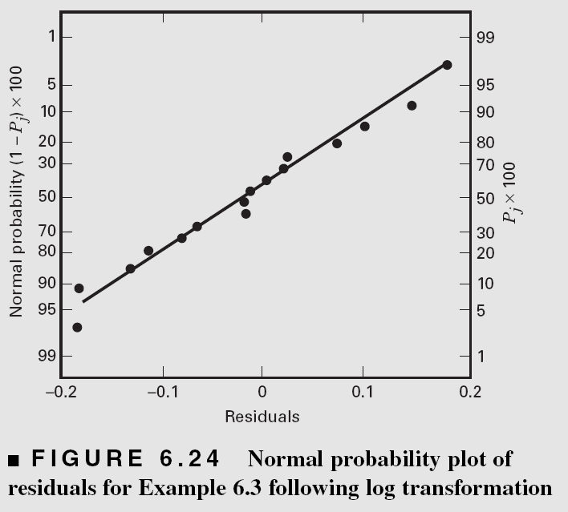
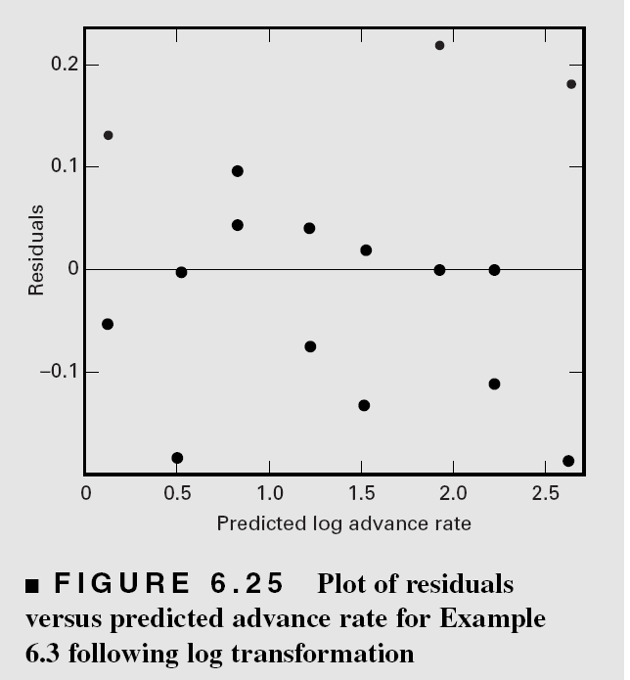
Following the Log Transformation

Slide 53
The Log Advance Rate Model
Is the log model “better”?
We would generally prefer a simpler model in a transformed scale to a more complicated model in the original metric
What happened to the interactions?
Sometimes transformations provide insight into the underlying mechanism

Slide 54
Other Examples of
Unreplicated 2^{k} Designs
The sidewall panel experiment (Example 6.4, pg. 245)
  Two factors affect the mean number of defects
  A third factor affects variability
  Residual plots were useful in identifying the dispersion effect
The oxidation furnace experiment (Example 6.5, pg. 245)
  Replicates versus repeat (or duplicate) observations?
  Modeling within-run variability

Slide 55
Other Analysis Methods for
Unreplicated 2^{k} Designs
Lenth’s method (see text, pg. 235)
  Analytical method for testing effects, uses an estimate of error formed by pooling small contrasts
  Some adjustment to the critical values in the original method can be helpful
  Probably most useful as a supplement to the normal probability plot
Conditional inference charts (pg. 236)

Slide 56
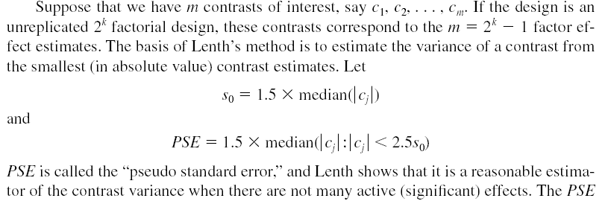
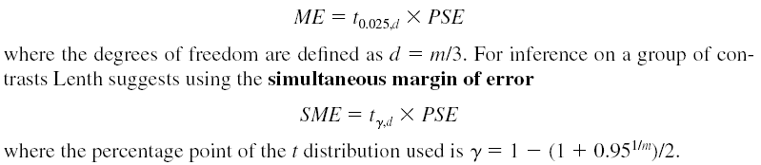
Overview of Lenth’s method
For an individual contrast, compare to the margin of error

Slide 57
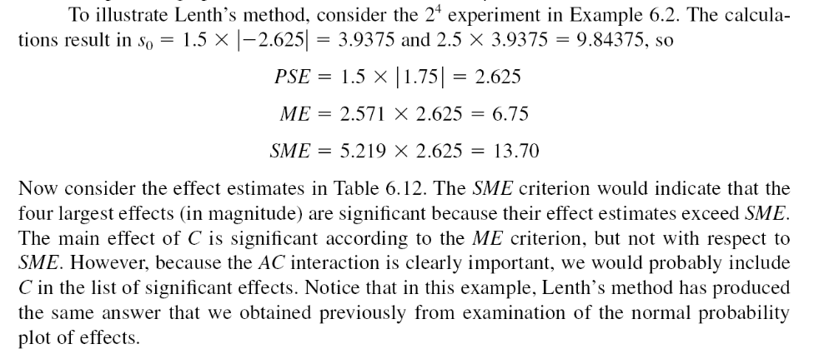

Slide 58
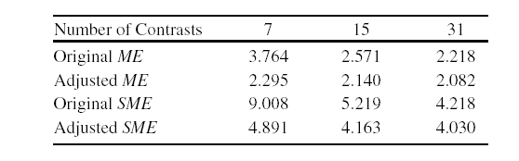
Adjusted multipliers for Lenth’s method
Suggested because the original method makes too many type I errors, especially for small designs (few contrasts)
Simulation was used to find these adjusted multipliers
Lenth’s method is a nice supplement to the normal probability plot of effects
JMP has an excellent implementation of Lenth’s method in the screening platform

Slide 59
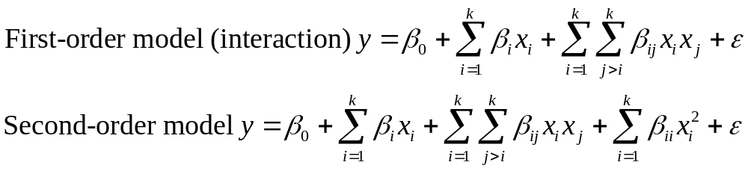
Addition of Center Points to a 2^{k} Designs
Based on the idea of replicating some of the runs in a factorial design
Runs at the center provide an estimate of error and allow the experimenter to distinguish between two possible models:

Slide 60
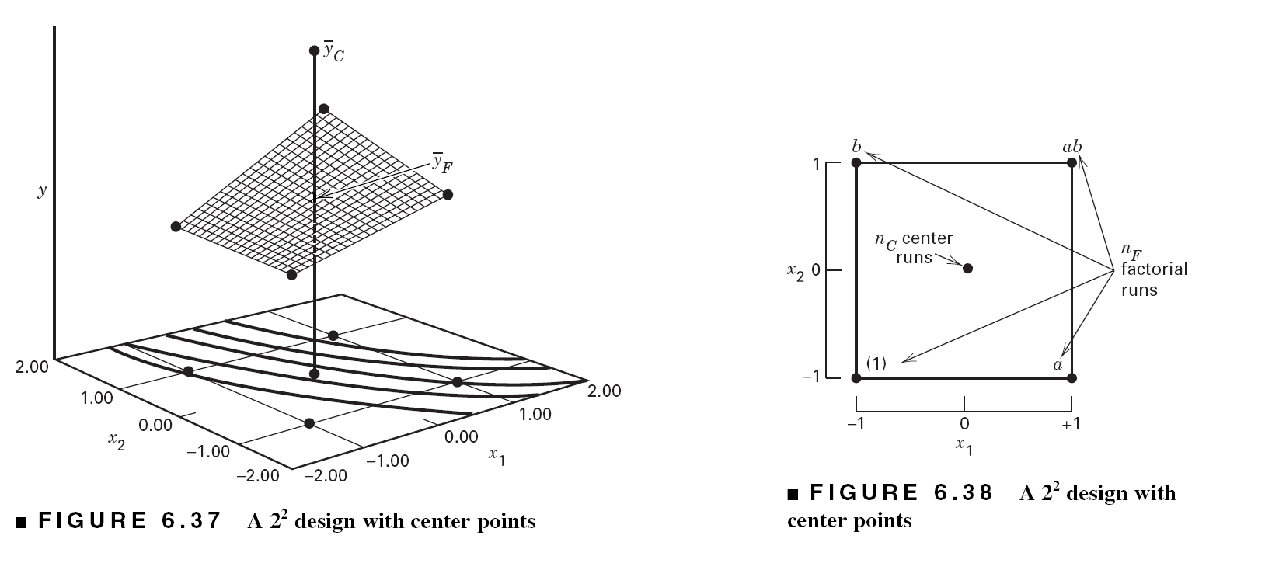

Slide 61
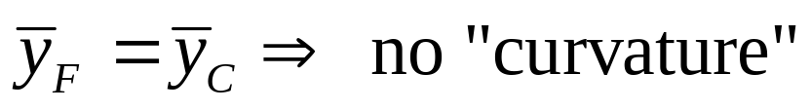



The hypotheses are:
This sum of squares has a single degree of freedom

Slide 62

Example 6.6, Pg. 248
Refer to the original experiment shown in Table 6.10. Suppose that four center points are added to this experiment, and at the points x1=x2 =x3=x4=0 the four observed filtration rates were 73, 75, 66, and 69. The average of these four center points is 70.75, and the average of the 16 factorial runs is 70.06. Since are very similar, we suspect that there is no strong curvature present.
Usually between 3 and 6 center points will work well
Design-Expert provides the analysis, including the F-test for pure quadratic curvature

Slide 63



Slide 64

ANOVA for Example 6.6 (A Portion of Table 6.22)

Slide 65

If curvature is significant, augment the design with axial runs to create a central composite design. The CCD is a very effective design for fitting a second-order response surface model

Slide 66
Practical Use of Center Points (pg. 260)
Use current operating conditions as the center point
Check for “abnormal” conditions during the time the experiment was conducted
Check for time trends
Use center points as the first few runs when there is little or no information available about the magnitude of error
Center points and qualitative factors?

Slide 67

Center Points and Qualitative Factors

